Slide 1
Govt. Gajanan Madhav Muktibodh Mahavidhyalaya Sahaspuir Lohara
Dist. Kabirdham (C.G.)
PRESENTED BY
Mr. Rupesh Kumar Verma
(ASSISTANT PROFESSOR)
SESSION - 2022-23

Slide 6
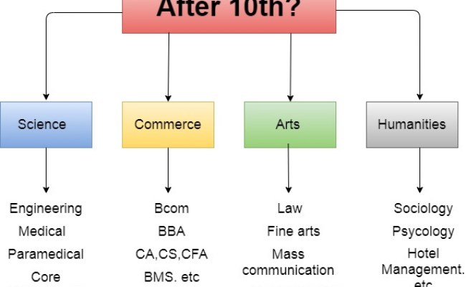

Slide 7
